Slide 1
FATCA and the Trust Industry - Current Practical Issues
STEP Lausanne / Luncheon Meeting
Erol Baruh

Slide 2
Table of Contents
Introduction
Classification of entities (FFI vs. NFFE)
Compliance method
Due diligence
FATCA documentation
Reporting
Treaty Requests
Responsible officer certification

Slide 3
Introduction
FATCA’s main purpose and basic design
Enacted in 2010 for the purpose of preventing tax evasion by US persons.
New chapter to the U.S. Internal Revenue Code (Chapter 4)
U.S. Treasury regulations
Intergovernmental agreements (IGAs):
Model 1 (UK, France, Germany, Italy, Spain, Singapore,…)
Model 2 (Switzerland, Japan, Hong-Kong,…)
FFI Agreement (Notice 2014/13 – January 2014)
New accounts vs. Preexisting accounts (legacy)
Individual accounts vs. Entity accounts

Slide 4
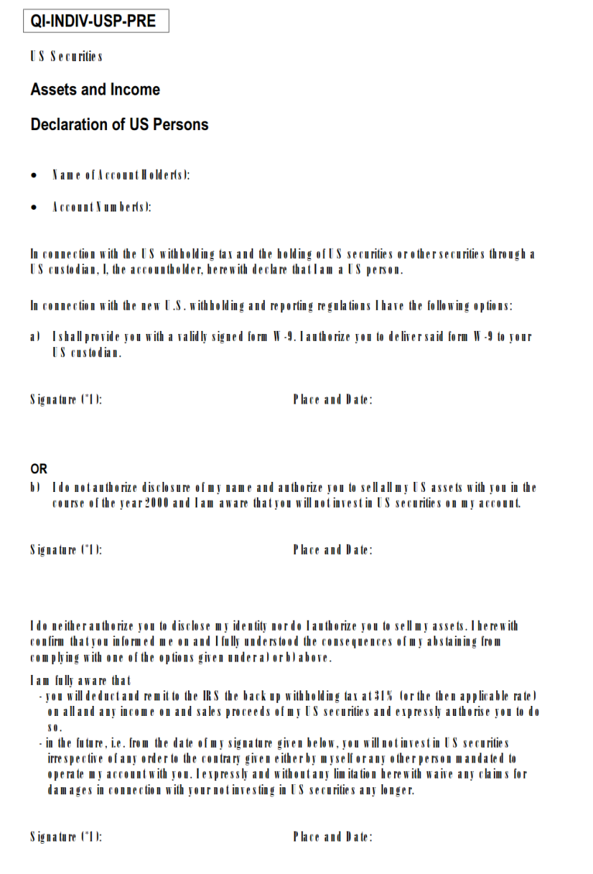
Qualified Intermediary System (2001)
Individual accounts
An account held by a U.S. individual taxpayer with a foreign bank was not reportable to the IRS under the QI if did not contain any U.S. securities
“I do not authorize disclosure of my name and authorize you to sell all my U.S. assets with you in the course of the year 2000 and I am aware that you will not invest in U.S. securities on my account”
A Swiss Bank considered an Account of that kind as blocked for investments in the U.S.
By contrast, FATCA is designed to require reporting to the IRS of an account held by a U.S. taxpayer, even if this account contains no U.S. asset.

Slide 5
Qualified Intermediary System (2001)
Entity accounts
An account held by a (non-transparent) foreign entity was not reportable to the IRS, even if the entity is ultimately held or controlled by a U.S. Person.
“For the assessment whether a client is a U.S. person or a non-U.S. person as well as for the determination as to whether a client is the beneficial owner of certain assets, a QI bank, according to the QIA, is allowed to generally assume that an IRS form (W-9, W-8BEN, W-8IMY) properly filled out by the client reflects the truth, respectively that the client data collected in accordance with the KYC-rules accepted by the IRS is correct. During the negotiations for the QIA, the IRS had (orally) confirmed that a Form A used for the assessment of the beneficial owner in accordance with Swiss anti-money laundering law was not relevant for QI purposes. For assessing the beneficial owner in accordance with U.S. tax law, the QI bank can thus generally rely on a signed IRS form or an adequate substitute in its possession. Potential discrepancies to a Form A in possession of the QI are generally irrelevant.”
FATCA is designed to result not only in the disclosure to the IRS of accounts held directly by U.S. Person but also of accounts held by foreign structures/vehicles substantially owned or controlled by U.S. Persons.

Slide 6
FATCA Overview
Withholding
Reporting
Due Diligence
FATCA Qualification Committee
Committee led by the State Secretariat for International Financial Matters (SIF). Includes representatives of:
Swiss Federal Tax Administration
Swiss Federal Social Insurance Office
Swiss Bankers Association SBA
Swiss Association of Pension Funds ASIP
Swiss Insurance Association SIA
Swiss Funds & Asset Management Association SFAMA
SwissHoldings
Swiss Association of Asset Managers SAAM
SIX Group
The FATCA Qualification Committee addresses questions arising from the implementation of the Swiss IGA.

Slide 7
Table of Contents
Introduction
Classification of entities (FFI vs. NFFE)
Compliance method
Due diligence
FATCA documentation
Reporting
Treaty Requests
Responsible officer certification

Slide 8
FATCA classification (FFI vs. NFFE)
“Entity” means a legal person or a legal arrangement such as a trust.
Foreign Financial Institution (FFI)
FFIs report information to the IRS / local tax authority.
Non-Financial Foreign Entity (NFFE)
NFFEs disclose information about their U.S. owners or controlling persons to the FFI that maintains their account.

Slide 9
FATCA classification (FFI vs. NFFE)
Foreign Financial Institution
Depositary Institution (banks)
Insurance Company
Custodial Institution
Investment entity
Investment Entity
Category primarily aimed at investment funds and their managers, but is broadly defined and includes private structures that hold investments.
Manages portfolio or otherwise invests or administers financial assets on behalf of customers
Category relevant for trustees (Type A)
Derives income principally from investing in financial assets and is “professionally managed” (i.e. is managed by a bank or a Type A investment entity) Category relevant for trusts (Type B)

Slide 10
FATCA classification (FFI vs. NFFE)
Investment Entity - financial income test
Under U.S. Treasury Regs, an Entity only qualifies as Type A Investment Entity if its gross income attributable to its financial asset management activities on behalf of customers exceeds 50% of its gross income over the last 3 years.
This test also applies under Swiss IGA, according to guidance issued by the Swiss Qualification Committee. This may be relevant for fiduciary companies, law firms or investment management company acting only on behalf of affiliated companies.
This same reasoning likely applies in connection with the provision the U.S. Treasury Regs according to which a Type B Investment Entity (i.e. a trust) qualifies as FFI only if its income is primarily (i.e. over 50%) attributable to financial assets.

Slide 11
FATCA classification (FFI vs. NFFE)
Example #1
X, an individual, establishes Trust A, a non-grantor non-U.S. trust for the benefit of X's children, Y and Z. X appoints Trustee A, an individual, to act as the trustee of Trust A. Trust A's assets consists solely of financial assets, and its income consists solely of income from those financial assets. Pursuant to the terms of the trust instrument, Trustee A manages and administers the assets of the trust. Trustee A does not hire any entity as a third-party service provider to perform any asset management activities, so manages the assets himself.

Slide 12
FATCA classification (FFI vs. NFFE)
Example #2
Same facts except that X hires Trust Company (an FFI) to act as trustee on behalf of Trust A. Trust Company manages and administers the assets of Trust A in accordance with the terms of the trust instrument for the benefit of Y and Z.

Slide 13
FATCA classification (FFI vs. NFFE)
Example #3
Same facts with Trust Company as a trustee, except that Trust A's assets consist solely of direct interests in real estate located within the United States and abroad.

Slide 14
FATCA classification (FFI vs. NFFE)
Example #4
Same facts, except that:
Trust A further includes artwork, jewelry and an airplane; and
the trustee of Trust A holds the assets of Trust A through an underlying company (UC).

Slide 15
FATCA classification (FFI vs. NFFE)
Example #5
Same facts except that the assets in Trust A are predominantly financial and X, the settlor, creates a private trust company (PTC) to administer the trust and act as trustee. PTC is run by family members of X.

Slide 16
FATCA classification (FFI vs. NFFE)
Example #6
An individual creates a SPV. The SPV holds exclusively financial assets. One of the SPV’s director is a Swiss entity (a company limited by shares). As director, the Swiss entity has authority to manage / dispose of the SPV’s bank accounts.

Slide 17
FFI Trusts
Beneficiary 2
Financial account under FATCA means
Depositary account (upstream account)
Custodial account (upstream account)
Equity or interest in an Investment Entity (downstream account)
“Account Holder(s)” of a FFI Trust = owner(s) of an equity interest in the trust
Equity interest in a trust (U.S. tax law!)
A person who is an owner of all or a portion of the trust (grantor trust)
A beneficiary who is entitled to a mandatory distribution from the trust
A beneficiary who may receive a discretionary distribution from the trust but only if such person receives a distribution in the calendar year.
Settlor
Downstream account
Downstream account
Trust
Beneficiary 1
Downstream account
Underlying Company
Upstream account
Bank deposit

Slide 18
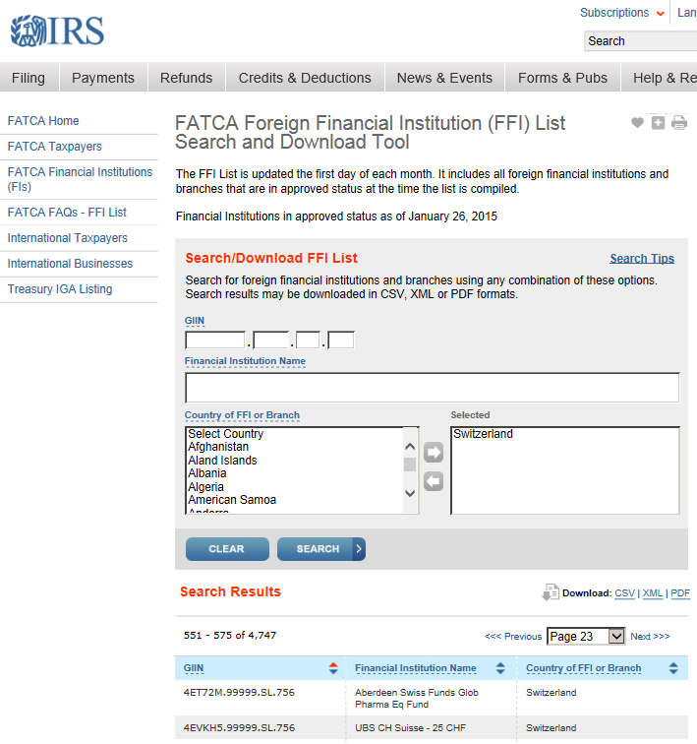
FFI Trusts
Compliance Methods
Directly registering with the IRS
Participating FFI / Reporting Model 1 or 2 FFI
Arranging for a third-party (trustee, sponsor or bank) to undertake FATCA responsibility
Deemed-Compliant FFI
Registered (with GIIN)
Trustee-documented Trust
Sponsored investment entity
Certified (without GIIN)
Sponsored investment entity (closely held – 20 or fewer investors)
Investment advisors and managers
Owner-documented FFIs

Slide 19
NFFE Trusts
NFFE Trusts as U.S. Account Holders
Accounts that are held by Passive NFFEs with one or more Controlling Persons who are U.S. citizens or residents shall be treated as U.S. Accounts.
U.S. Controlling persons
For trusts, Controlling Person means the settlor, the trustee, the protector (if any), the beneficiaries or class of beneficiaries, and any other natural person exercising ultimate effective control over the trust.
According to Qualification Committee, the concept of Controlling Person shall be interpreted the same way as the concept of beneficial owner under Swiss Anti-Money Laundering Act / Swiss Bank's code of conduct on the exercise of Due Diligence (CDB).
Swiss FFI have to identify Controlling Persons behind the trust and obtain appropriate documentation from them. If the trust has a U.S. Controlling Person, the (upstream) account is considered as U.S. and is reported to the IRS.

Slide 20
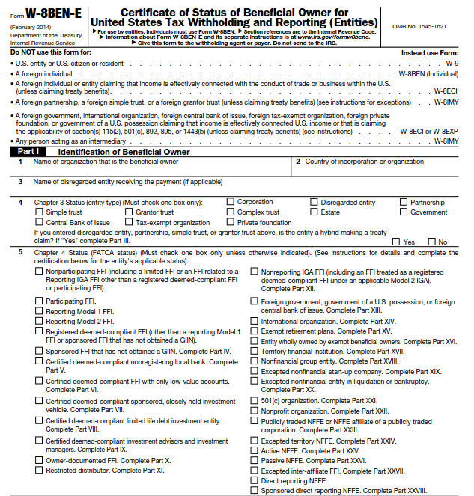
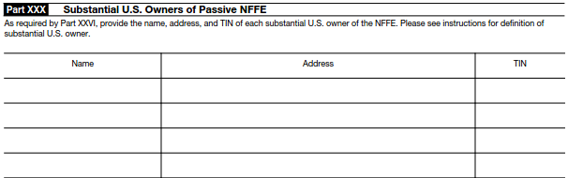
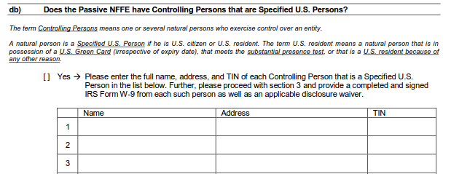
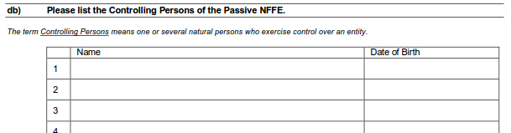
NFFE Trusts
W-8BEN-E
SBA - Option A
SBA - Option B

Slide 21
NFFE Trusts
Active and otherwise exempted NFFE
Active trade of business (manufacturing, construction, retail, utilities,…)
Less than 50% of its income are passive income (dividends, interests,…)
Less than 50% of its assets generate passive income
Holding companies and treasury centers (of a non-financial group)
Non-profit organization
Established for religious, charitable, scientific, artistic purposes
Exempt from tax in its country of residence
Active NFFE accounts are deemed not to be U.S. Accounts. No reporting and no withholding is required. Accounts do not need to be considered when applying procedures to identify U.S. Persons.

Slide 22
Table of Contents
Introduction
Classification of entities (FFI vs. NFFE)
Compliance method
Due diligence
FATCA documentation
Reporting
Treaty Requests
Responsible officer certification

Slide 23
Due DiIligence
U.S. Indicia
U.S. citizen or resident;
U.S. place of birth;
U.S. mailing or residence address (including a U.S. PO box or “in-care-of”);
U.S. telephone number;
Standing instructions to transfer funds to an account maintained in the U.S.;
Currently effective power of attorney or signatory authority granted to a person with a U.S. address; or
An “in-care-of” or “hold mail” address that is the sole address on file
Curative documents
Self-certification; and/or
Documentary evidence; and/or
Additional documents (e.g. certificate of loss of nationality, evidence that a person is not a beneficial owner); and/or
Reasonable written explanation supporting claim of foreign status
An FFI may not rely on a self-certification or documentary evidence if the FFI knows or has reason to know that the self-certification or documentary evidence is incorrect or unreliable

Slide 24
Table of Contents
Introduction
Classification of entities (FFI vs. NFFE)
Compliance method
Due diligence
FATCA documentation
Reporting
Treaty Requests
Responsible officer certification

Slide 25
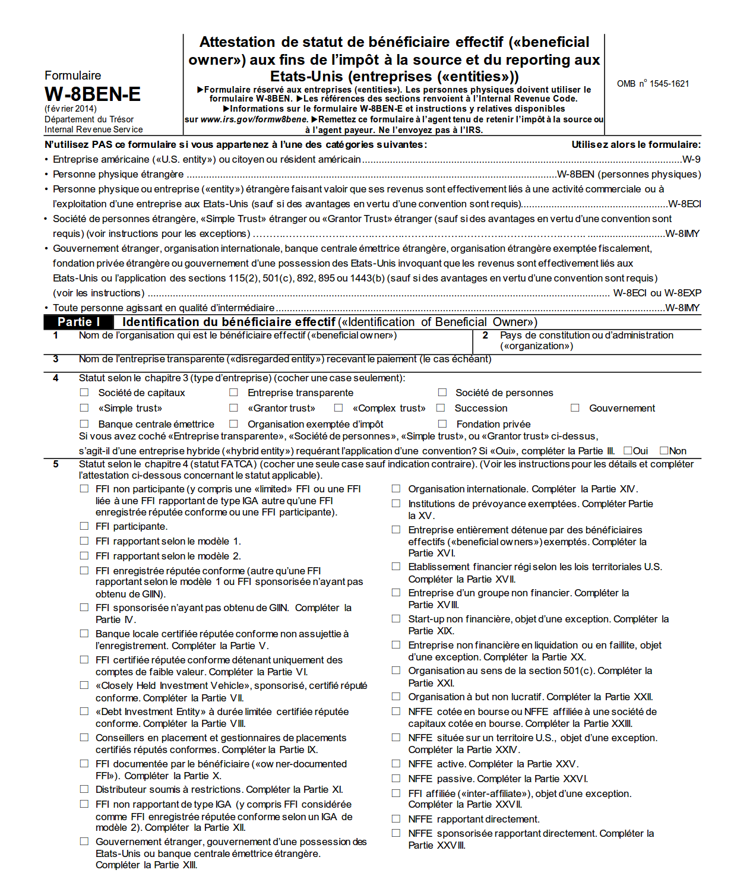
FATCA Documentation
Withholding certificates
U.S. Person
W-9
Non-U.S. Person
W-8BEN (Individual)
W-8BEN-E (Entity)
W-8IMY (QI-related)
Instructions
French / German Translations
Signature by proxy
Validity
Electronic transmission

Slide 26
FATCA documentation
Self-certification - U.S. tax status declaration
Aims at determining whether a person is subject to U.S. tax on worldwide income:
U.S. citizen (including dual citizens)
U.S. resident (green card, substantial presence test)
Subject to U.S. tax for other reasons
Includes identification details on the person reviewed
Place of birth / Citizenship(s) / Date of birth
Includes client’s certification of non U.S. / U.S. status
Includes undertaking to inform the FFI in case of change of circumstances
The Internal Revenue Service does not require your consent to any provision of this document other than the certifications required to avoid backup withholding.”
Specific form for certification of NFFE (Swiss equivalent of W-8BEN-E)

Slide 27
FATCA documentation
Consent to report
Swiss specific document (linked with Model II setup)
Standard Content
Reasons for reporting
Description of potential recipients
Description of covered information
Release of applicable obligation of confidentiality
Contractual or legal
Swiss of foreign
Warning that information becomes subject to the laws of the US
Automatically renewed until revoked in writing

Slide 28
FATCA documentation
Consent to report – FTA letter
Swiss FFIs have been required to inform the Account Holder through a letter of the Swiss Federal Tax Administration (FTA) that, if the U.S. TIN and such consent are not given, (1) aggregate information about the account shall be reported to the IRS, (2) information about the account may give rise to a group request by the IRS for specific information about the account, (3) in such case, the account information shall be transmitted to the FTA, and (4) the FTA may exchange this information with the IRS in accordance with the IGA.
Swiss FFI will be required to obtain similar consent and send similar FTA letter to nonparticipating FFIs:
that exist as of December 31, 2013; and
in connection with which Swiss FFI expects to pay a Foreign Reportable Amount.
Foreign Reportable Amount means a payment of fixed or determinable annual or periodical income that would be a withholdable payment if it were from sources within the United States.

Slide 29
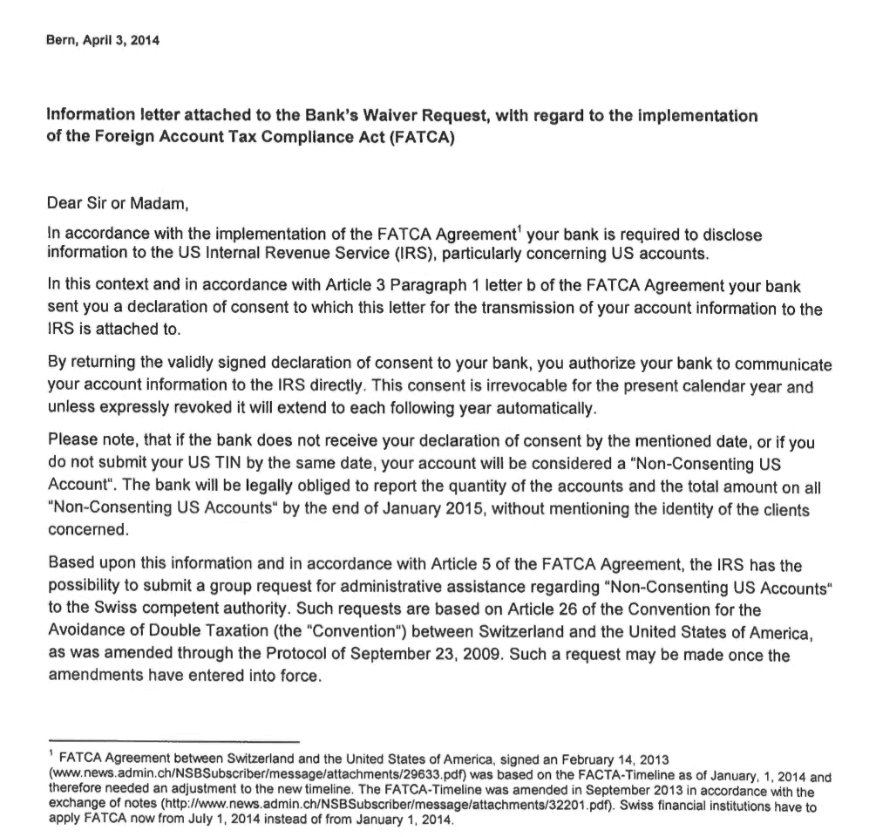
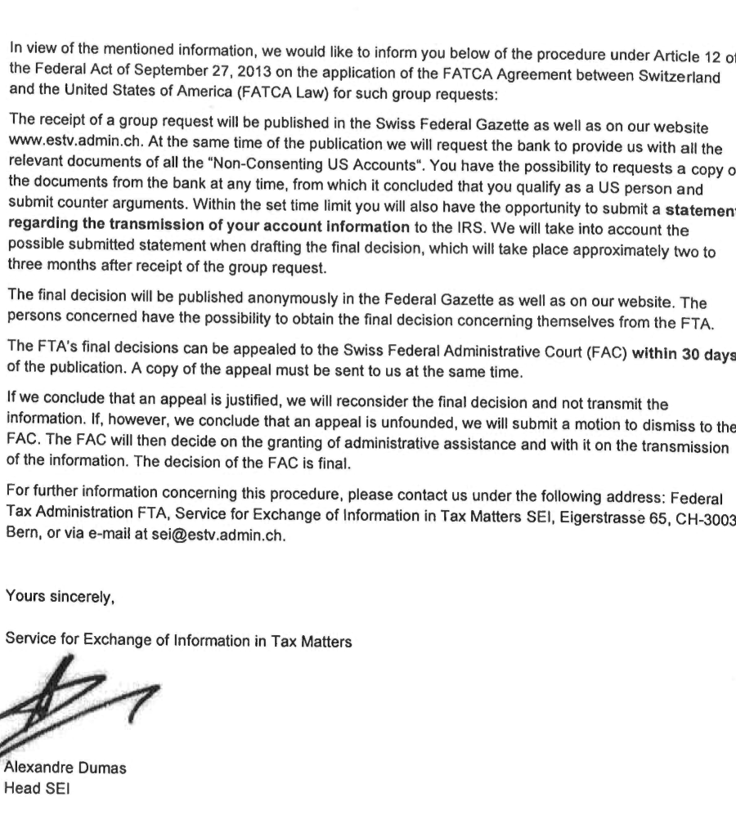
FATCA documentation

Slide 30
Table of Contents
Introduction
Classification of entities (FFI vs. NFFE)
Compliance method
Due diligence
FATCA documentation
Reporting
Treaty Requests
Responsible officer certification

Slide 31
FATCA Reporting
Aggregate Reporting vs. Individual Reporting
31 January, each year
Obligation to report aggregate data on:
Non-Consenting U.S. Accounts
Non-Participating Financial Institution (only for 2015 and 2016)
31 March, each year
Obligation to report individualized data on other U.S. Accounts
International Data Exchange Service (IDES)
Postponement of first aggregate reporting from 31/01/2015 to 31/03/2015 (IDES available only since 12/01/2015)

Slide 32
Table of Contents
Introduction
Classification of entities (FFI vs. NFFE)
Compliance method
Due diligence
FATCA documentation
Reporting
Treaty Requests
Responsible officer certification

Slide 33
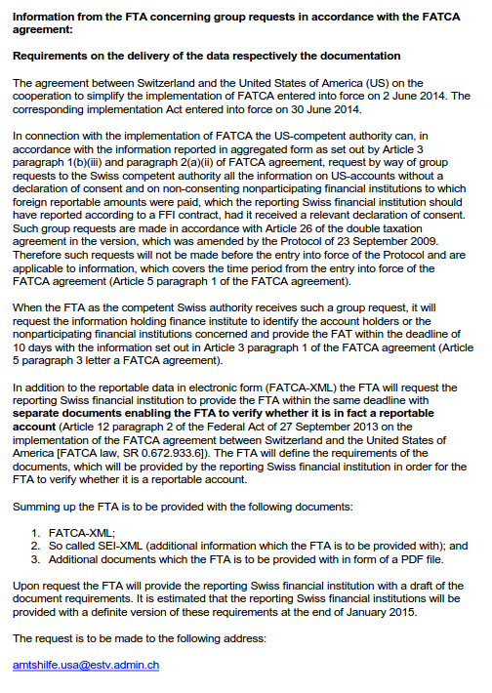
Treaty Requests
In the context of FATCA implementation, the U.S. Competent Authority may make group requests to the Swiss Competent Authority, based on the aggregate information reported to the IRS for all the information about Non-Consenting U.S. Accounts and Foreign Reportable Amounts paid to non-consenting Nonparticipating Financial Institutions.
Swiss Federal Tax Administration to issue guidelines for the documentation, which has to be transferred to the FTA within 10 days from receipt of the demand in connection with group requests (by mid February 2015).

Slide 34
Table of Contents
Introduction
Classification of entities (FFI vs. NFFE)
Compliance method
Due diligence
FATCA documentation
Reporting
Treaty Requests
Responsible officer certification

Slide 35
Responsible officer certifications
A participating FFI must appoint a responsible officer.
A participating FFI is required to adopt a compliance program under the authority of the responsible officer, including policies, procedures, and processes sufficient for the participating FFI to satisfy the due diligence, reporting, and withholding requirements of the FFI Agreement.
No later than 60 days following the date that is two years after the effective date of this agreement, the responsible officer must:
certify completion of the due diligence procedures for preexisting accounts;
certify the absence of any formal or informal practices or procedures to assist account holders in the avoidance of FATCA.

Slide 36
Automatic Exchange of Information
OECD Multilateral Competent Authority Agreement on the Automatic Exchange of Financial Account Information (“MCAA”)
Common standard on reporting and due diligence for financial account information (“Common Reporting Standard”- “CRS”)
Federal Act on the International Automatic Exchange of Information in Tax Matters (AEOI Act) governs the implementation of the AEOI standard and contains provisions on the organisation, the procedure, judicial channels and the applicable criminal provisions
Controlling Person / Investment Entity under AEI framework

Slide 37
Thank you for your attention.
Erol Baruh
Erol.Baruh@swlegal.ch
Schellenberg Wittmer Ltd / Attorneys at Law
15bis, rue des Alpes / P.O. Box 2088 / 1211 Geneva 1 / Switzerland
T +41 22 707 8000 / F +41 22 707 8001
www.swlegal.ch
GENEVA / ZURICH / SINGAPORE

